Slide 1
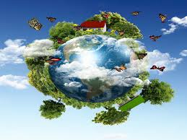
ENVIRONMENT

Slide 2
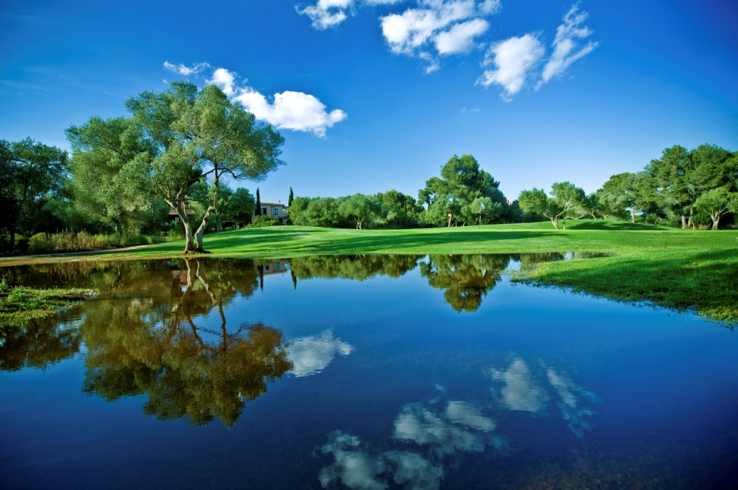
Every organism in this earth is surrounded by a lot of things; say other organisms, plants, water, air, light, land etc. These surroundings of the organism, all the living and non-living things constitute its environment.

Slide 3
Environment can be defined as the natural surroundings of that organism which directly or indirectly influences the growth and development of the organism. Environment is the total sum of all living and non living factors that compose the surroundings of man

Slide 4
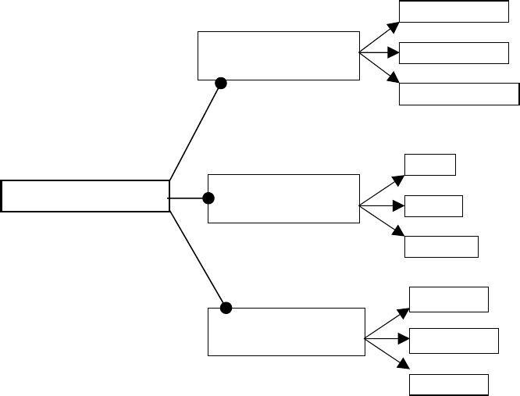
CLASSIFICATION OF ENVIRONMENT
Atmosphere
PHYSICAL
ENVIRONMENT
Hydrosphere
Lithosphere
Floral
ENVIRONMENT
BIOLOGICAL
ENVIRONMENT
Faunal
Microbia
Society
CULTURAL
ENVIRONMENT
Economy
Politics

Slide 5
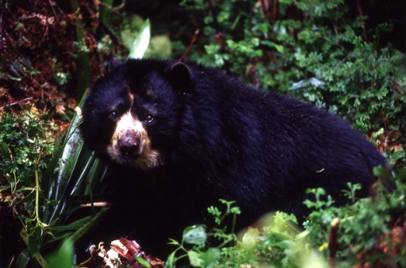
The biological environment as the name indicates refers to the various flora (plants), fauna (animals) and microbes (micro organisms) that are found in our surroundings.

Slide 6
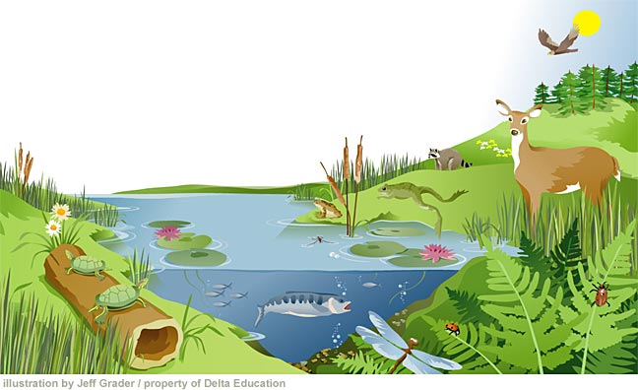
Ecosystem
An ecosystem is a biological environment consisting of all the organisms living in a particular area, as well as all the nonliving, physical components of the environment with which the organisms interact, such as air, soil, water, and sunlight.^{[1]}
It is all the organisms in a given area,
along with the nonliving (abiotic)
factors with which they interact; a
biological community and its physical
environment.
[1] Biology Concepts & Connections Sixth
Edition”, Campbell, Neil A. (2009),
page 2, 3 and G-9. Retrieved 2010-06-14.

Slide 7
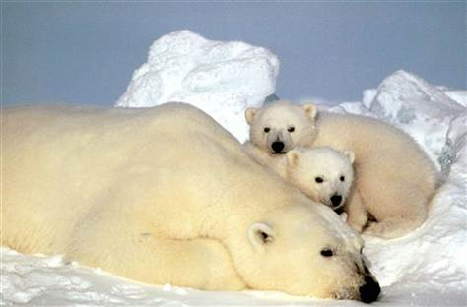
Biotic Factors
Biotic, meaning of or related to life, are living factors. Plants, animals, fungi, protist and bacteria are all biotic or living factors.
Biotic factors grow
Biotic factors change
Biotic factors show movement
Biotic factors breath
Biotic factors take substances from their environment
Biotic factors produce young
React to changes around them

Slide 8
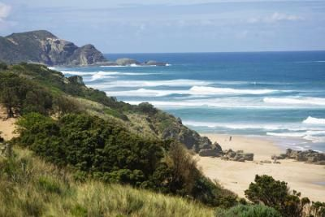
Abiotic Factors
Abiotic, meaning not alive, are nonliving factors that affect living organisms. Environmental factors such habitat (pond, lake, ocean, desert, mountain) or weather such as temperature, cloud cover, rain, snow, hurricanes, etc. are abiotic factors.
Abiotic factors do not need
food and water
Abiotic factors do not grow
on their own
Abiotic factors do not change
on their own

Slide 9
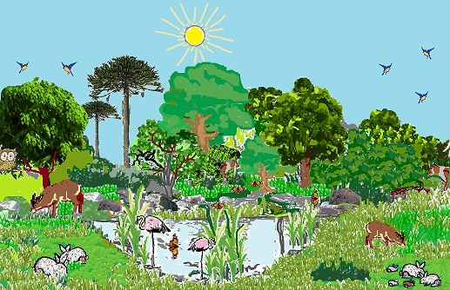
A System
Biotic and abiotic factors combine to create a system or more precisely, an ecosystem. An ecosystem is a community of living and nonliving things considered as a unit.

Slide 10
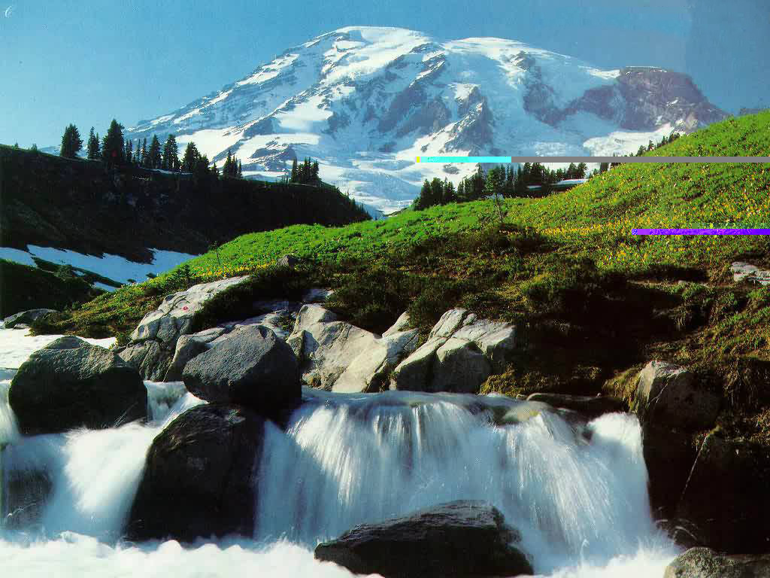
Biotic and abiotic factors are interrelated. If one factor is changed or removed, it impacts the availability of other resources within the system.

