Slide 1
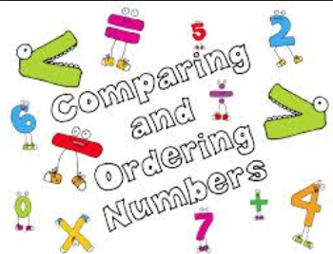
Compare and Order Whole Numbers

Slide 2
REMEMBER!!!
Symbols are used to show how the size of one number compares to another. These symbols are:
< (is less than), > (is greater than), and = (is equal to.)

Slide 3
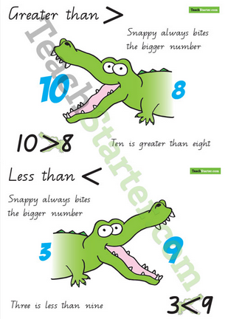

Slide 4
For example, since 2 is smaller than 4 and 4 is larger than 2, we can write:
2 < 4, which says the same as
4 > 2 and of course, 4 = 4.

Slide 5
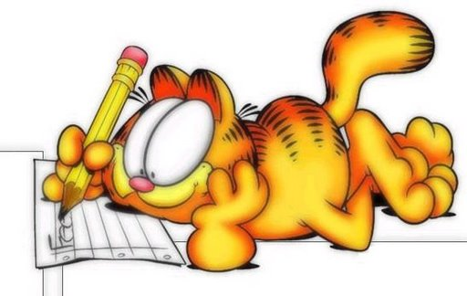
To compare whole numbers:
First step:.
Aling the digits by place value
th h t o
6,453
6,459
Second Step:
Start at the left and find the first place where the digits are different:
Compare the digits in the greatest place
6,453
6,459 6 = 6
If these digits are the same, compare the next digits
6,453
6,459 4 = 4
Keep comparing numbers until you find two digits that are not the same
6,453 5 = 5
6,459 3 < 9
So: 6,453 < 6,459. You can say that 6,459 > 6,453

Slide 6
Study this Example:
69,520 69,520 69,520
19,478 19,478 19,478
160,434 160,434 160,434
63,215 63,215 63,215
In order from greatests to least, the numbers are:
160,434; 69,520; 63,215; 19,478
The order from least to greatest is:
19,478; 63,215; 69,520; 160,434
There are no hundred thousands in the other numbers. 160,434 is the greatest
6=6 and 1<6
19,478 is the least
3 < 9
63,215 < 69,520

Slide 7
Activity 1.
Compare. Write <, = or >.
1. 185,653 ____ 62, 854
2. 48,954 ____ 48,956
3. 698,582 ____ 698,528
4. 843,649 ____ 843,641
5. 798,349 ____ 798,349
6. 568,987 ____ 569,987

Slide 8
Activity 2
Write in order from least to greatest:
945,826; 945,839; 945,836;
945, 828
2. 199,407; 191,568; 190,999; 93,697
3. 395,174; 306,864; 369,831;354,738
4. 216,418; 215,783; 213,614; 221,986
5. 835,496; 835,486; 835,583; 835,587
6. 652,865; 568,256; 652,866; 587,687

